Slide 1
Keeping a Roof Over Your Head

Slide 2

Providing for a place to live along with the expenses that go with keeping a roof over your head can take a big portion of your paycheck. Deciding the best housing option for you is critical not only to making the most affordable choice but also the healthiest housing choice. Having a safe, comfortable, affordable place to live helps you to be healthier, both physically and emotionally. This lesson will discuss the various housing options, their costs and benefits, and the various issues that you may encounter when shopping for housing.

Slide 3
You will need to complete a study guide with this lesson. After you complete the lesson and study guide, please turn it into your teacher.

Slide 4
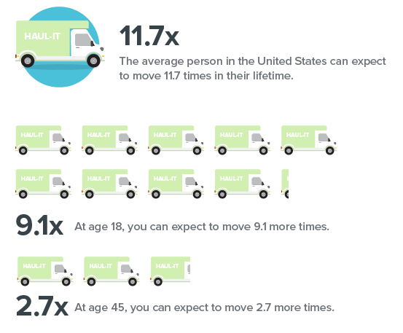
On the Move
Source: U.S. Census; www.smartaboutmoney.org
As you can see from this graphic, people
tend to move a lot during a lifetime. At age 18
you can expect to move over 9 more times! It is
estimated that it costs $1,450 to move locally, or
$25-$75 per hour. Moving across the country can
average $4,572. To make the best decisions for those
9+ moves, there are some basics you need to know
before beginning your housing search. In this lesson
we are going to focus on the things you need to
consider when renting a place to live rather than
purchasing a home. However, we will discuss the
advantages and disadvantages of both buying and
renting.
When you think you are ready to purchase a home,
consider attending a first-time Home Buyer
Education Class taught by a UT Extension agent in
your area before you begin the mortgage process.

Slide 5

Finding a place to live that fits your budget and lifestyle is very important at any stage of your life. When you are first starting out your housing options may be limited, whether by your budget or by where you live and what is available.
Questions you need to consider no matter whether you want to rent or own your home:
Will you be staying in your hometown?
Will you be moving to go to college?
Will you be moving to start a new job?
Will you be living with a roommate? Do you have pets?
Do you have money set aside for moving expenses?

Slide 6

Purchasing a home requires commitment to save money for a down payment and closing costs. Most lenders require 20% of the loan amount for the down payment. Also, a good credit history with a good credit score is required to get the best mortgage rates. THDA (Tennessee Housing Development Agency) offers loans to first-time homebuyers, and they require a minimum credit score of 640. Lenders want to see that you have steady employment, too.
Renting might be the better option if you are just starting out working and don’t know how long you plan to be in the area. If you are not sure of your plans, homeownership may not be your best option right now, so you should consider renting. Many rental companies run a credit check on you before renting to you. Even renting a house or apartment will require you have some money saved up for moving expenses. We will go into those in detail.
You can visit this website to compare the cost of buying vs renting
http://www.realtor.com/mortgage/tools/rent-or-buy-calculator/

Slide 7
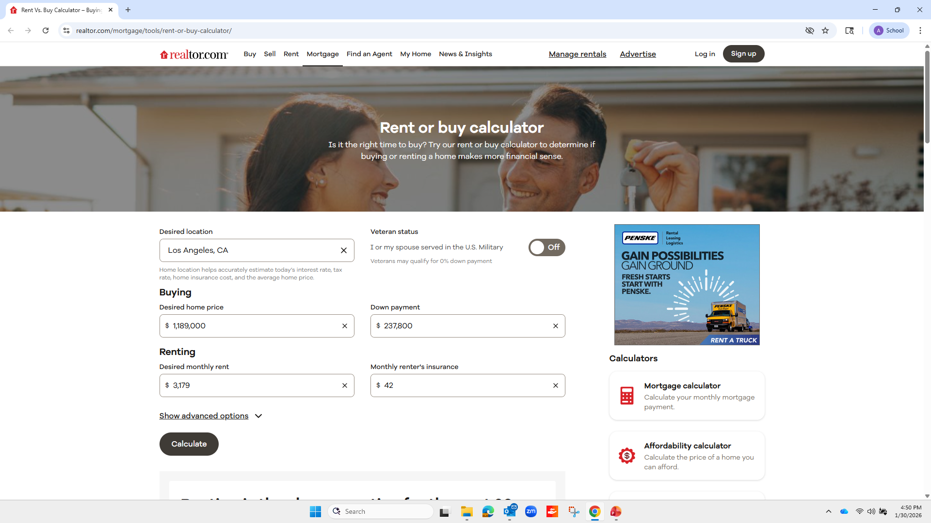

Slide 8
Pros and Cons of Buying
Potential Advantages
Potential Disadvantages
Typically increase in value over time
Home equity can be used to help with future financial goals
Pride in homeownership
You control the décor and remodeling
Tax deductions
It is a long-term financial commitment
You have to make all repairs and maintenance
Requires a considerable amount of money for down payment, closing costs and moving expenses
Can be difficult to sell quickly if you need to move

Slide 9
Pros and Cons of Renting
Potential Advantages
Potential Disadvantages
Short-term commitment. Easier to move on a short notice than if you were purchasing your home.
The landlord is responsible for repairs and maintenance.
While they can be expensive, move-in deposits are lower than the down payment and closing costs for purchasing a home.
You are not building any equity while paying rent.
No tax advantages.
Rent will probably increase from year to year.
May have restrictions on noise, pets, guests, etc.

Slide 10

Garage apartments, large apartment complexes with pools and workout rooms, trailers, duplexes and
single-family homes can all be choices in some areas that will be available to rent to keep a roof over
your head.

Slide 11
Pros and Cons of Renting an Apartment
Pros
Cons
Secure and private entry to the building
Greater chance of responsive landlord or property manager
May have pool or workout area
Shared space with all other residents—laundry rooms, etc.
May have noise issues
Pets may not be allowed

Slide 12
Pros and Cons of Renting a House
Pros
Cons
Typically, more room than an apartment
May be able to share with several roommates and reduce expenses
Better possibility that pets will be allowed
More likely to have private washer and dryer
May not be as safe or secure as an apartment, depending upon location and type of structure
May require more maintenance
The nicer the house and the less roommates you have, the more it will cost

Slide 13
Choosing Your Home
We are going to focus on renting for the rest of this lesson. Your choices in housing options to rent can vary depending upon where you live. What type of housing you can afford and what type of living environment you desire all come into play when selecting your home.
Other things to consider:
Location—close to your job, things to do
Safety of the neighborhood
Your space needs (# bedrooms/bathrooms)
Will you have roommates or family members?
Do you have pets? Will they need a yard?

Slide 14
Costs of Keeping a Roof over Your Head
According to ZillowRentals, in January 2026, the average monthly rent for a 2-bedroom apartment in the USA was $1,472. In Tennessee, the average cost was $1,513. Of course, these are averages, so the cost can vary widely by location.
Your rent will take the largest portion of your paycheck, so making your saving/spending plan with a rent that you can live comfortably with is critical. Ideally, your monthly rent and utilities should take no more than 30% of your monthly net (after tax) income.

Slide 15

Costs of Moving
There will be some costs that you will need to be prepared to pay upfront. Usually landlords will require certain deposits, and you will also have to think about other deposits and costs.
First and last month’s rent
Security deposit (TN does not limit the amount)
Pet deposit
Holding fees
Utility deposits
Moving costs-unless you have friends with a truck
Furniture

Slide 16
Landlord Rights and Responsibilities
When you rent a place to live, you need to get the agreement in writing. This written agreement is called a lease. The lease should state both the rights and duties of both you and the landlord.
Landlord Rights
Right to collect rent and prearranged late fees for overdue payment
Right to raise your rent according to your lease
Right to evict
May enter the dwelling without consent in the event of an emergency
Landlord Responsibilities
Keep the property safe and in good repair.
Not discriminate. Covered by the Fair Housing Act.
Responsible for working smoke alarms for rental units

Slide 17

Tenant Rights and Responsibilities
Tenant Rights
The right to a “quiet environment”
Cannot be discriminated against because of race, color, nationality, sex, or religion
Heating and air conditioning must work
Toilets and water heater must work
Door locks must work
Roof must be in good condition (no leaks)
Appliances that are supplied (refrigerator, stove) must be working

Slide 18
Tenant Rights and Responsibilities
Tenant Responsibilities
You must pay your rent on time.
You must obey the lease agreement.
You must obey all building and housing codes that materially affect health and safety.
Do not disturb your neighbors nor permit your guests to disturb the neighbors.
When you leave, the place should only have signs of normal use, no damage. Be sure to read your lease closely, as there may be other duties required when you move out, such as mowing the grass.
You must let your landlord come in at reasonable times to inspect it and to make repairs.
You must not engage in any illegal activity on the premises.
You will maintain the property in a clean and habitable condition.

Slide 19

Types of Leases
A lease is a legal agreement between you and a landlord. Leases obligate you and your landlord to specific commitments. You may need a co-signer if you are under a certain age or don’t have much credit history.
Once you find that perfect place to live and the monthly rent you can afford, the length of time you plan to obligate yourself to renting the apartment/home is critical. The lease obligates you to rent the place for a certain amount of time and the landlord to rent it to you for that length of time at that monthly rent. If you decide to leave before the lease is up, you are responsible for any of the remaining rent you owe for the time remaining on the lease.
Generally, the longer you agree to rent a place, the cheaper your rent will be.
Short-term lease: Fixed monthly rental rate for the entire duration of the lease. (Six months typical)
Month-to-month lease: You agree to rent for a month at a time. Can be more expensive. Your rental price could change at any time with appropriate notice by your landlord. If you are unsure of how long you will be in the area or just need a place for a limited time, this might be a good option. The landlord may cancel the lease by giving you 30 days’ notice.
Subleasing: Subleasing is renting under an original lease that someone else holds. Normally you work out arrangements with the original tenant rather than the landlord. Be sure to obtain written consent from the landlord allowing you to live in the house/apartment.
One year lease: Easiest lease to find and most standard. Protected against rent increases for the duration of the lease.

Slide 20
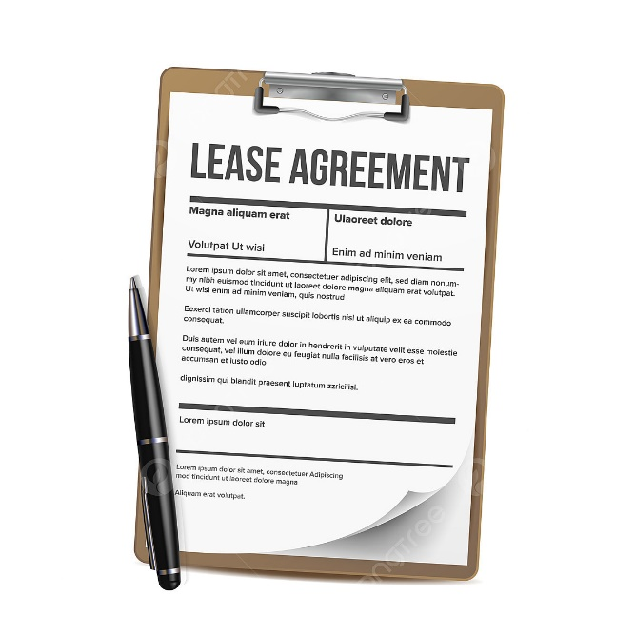
What to look for in a lease
Address of the place you are renting
Address and phone number of landlord
How much the rent is
How long the lease is for
When rent must be paid (due date each month)
If pets are okay. If so, size and kind and any extra deposit
Late fees for late rent payment
How much the security deposit is and when the landlord can keep it
Who pays for the electricity, gas, water, garbage, cable, etc.
When you or the landlord can end the lease
When the landlord can come into your place without your okay.

Slide 21
More about Leases and Security Deposits
Do not sign a lease that has blank spaces.
Get a signed copy and put it in a safe place. Everyone should sign it—you, the landlord, and anyone else who will be a renter.
The amount of the rent should be agreed upon and when it is due; both should be included in the lease agreement.
Always get a rent payment receipt and keep these in a safe place.
The security deposit pays for any damage you may cause beyond normal wear and tear. Get a receipt for the security deposit signed by the landlord that clearly states it was for the security deposit, the amount paid and the date. Tennessee has no limits on how much landlords can charge for these.

Slide 22
More about Leases and Security Deposits
Before you move in make a list of anything wrong with the dwelling. Then you cannot be charged for that damage when you move out. You should go over this list with the landlord and both sign it.
When you move you should get your entire security deposit if:
you don’t owe any rent
you have not damaged the property
your have not broken the lease
Don’t wait too long to ask for your deposit back. Ask for it in writing and give your new address.
Your landlord can keep your security deposit if you abandon your home. You abandon your home if:
1. You are behind on rent and leave fore 30 days or more without saying why OR
2. Your rent is 15 days late AND it looks like you have left for good.
If you abandon your home, the landlord can rent it to someone else. He can also sell anything you left there.

Slide 23
When You Can’t Pay Rent
Most landlords will not evict you if you are a bit late paying your rent, although you will probably be charged a late fee. But if you find that you cannot pay your rent or your income is drastically reduced, you need to be proactive and contact your landlord as soon as you know you are having difficulty.
Ask to negotiate a late payment in advance of your payment date
Offer to pay some of the rent by the due date
Explain your circumstances and how you expect to resolve
them so that your rent will be pain on time in the future

Slide 24

Find out housing costs (and other cool facts) for your town
Find your city and check out the housing costs. This can give you an idea of how to budget for housing costs when looking for a place to live.
http://www.city-data.com

Slide 25
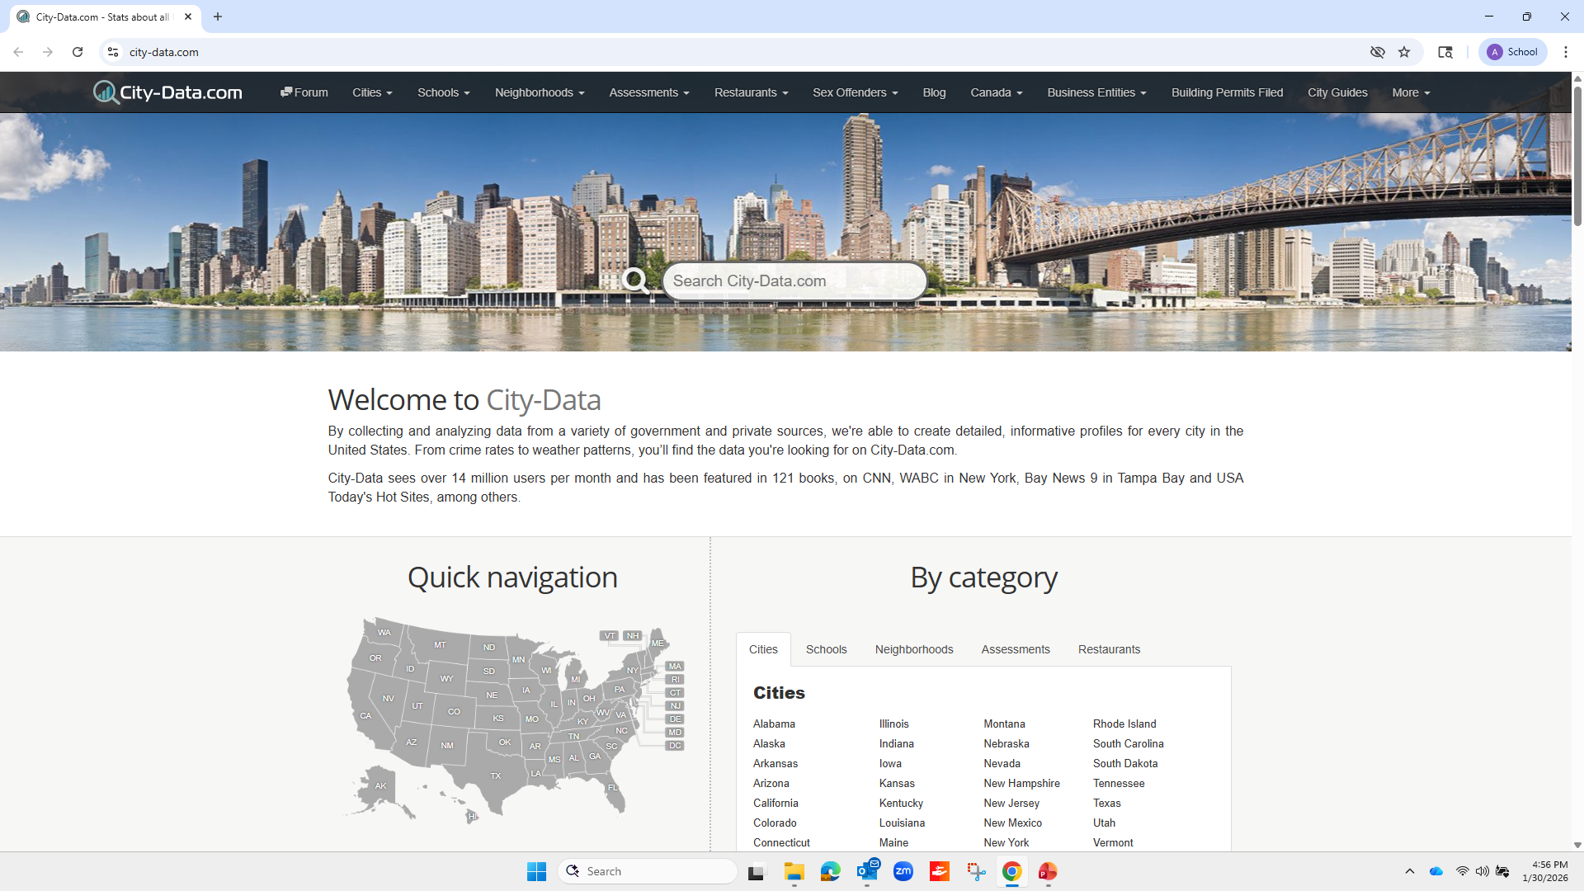

Slide 26
Athens
Let’s look at Athens. You can find the following information about the cost of housing and much more at the link.
Median monthly housing costs $852
Median rent for a vacant unit $873
Median price for vacant home for sale $236,099
http://www.city-data.com/housing/houses-Athens-Tennessee.html *use this link to complete the assignment in your Study Guide

Slide 27
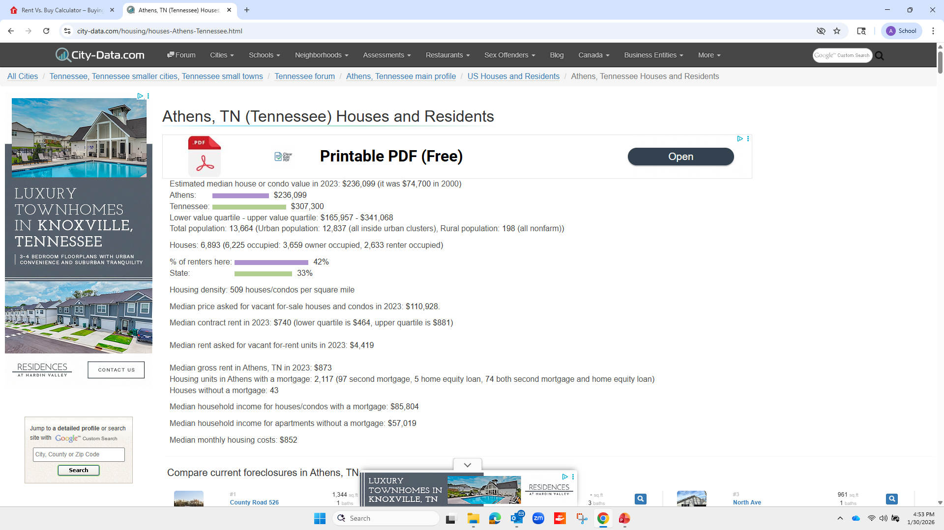

Slide 28
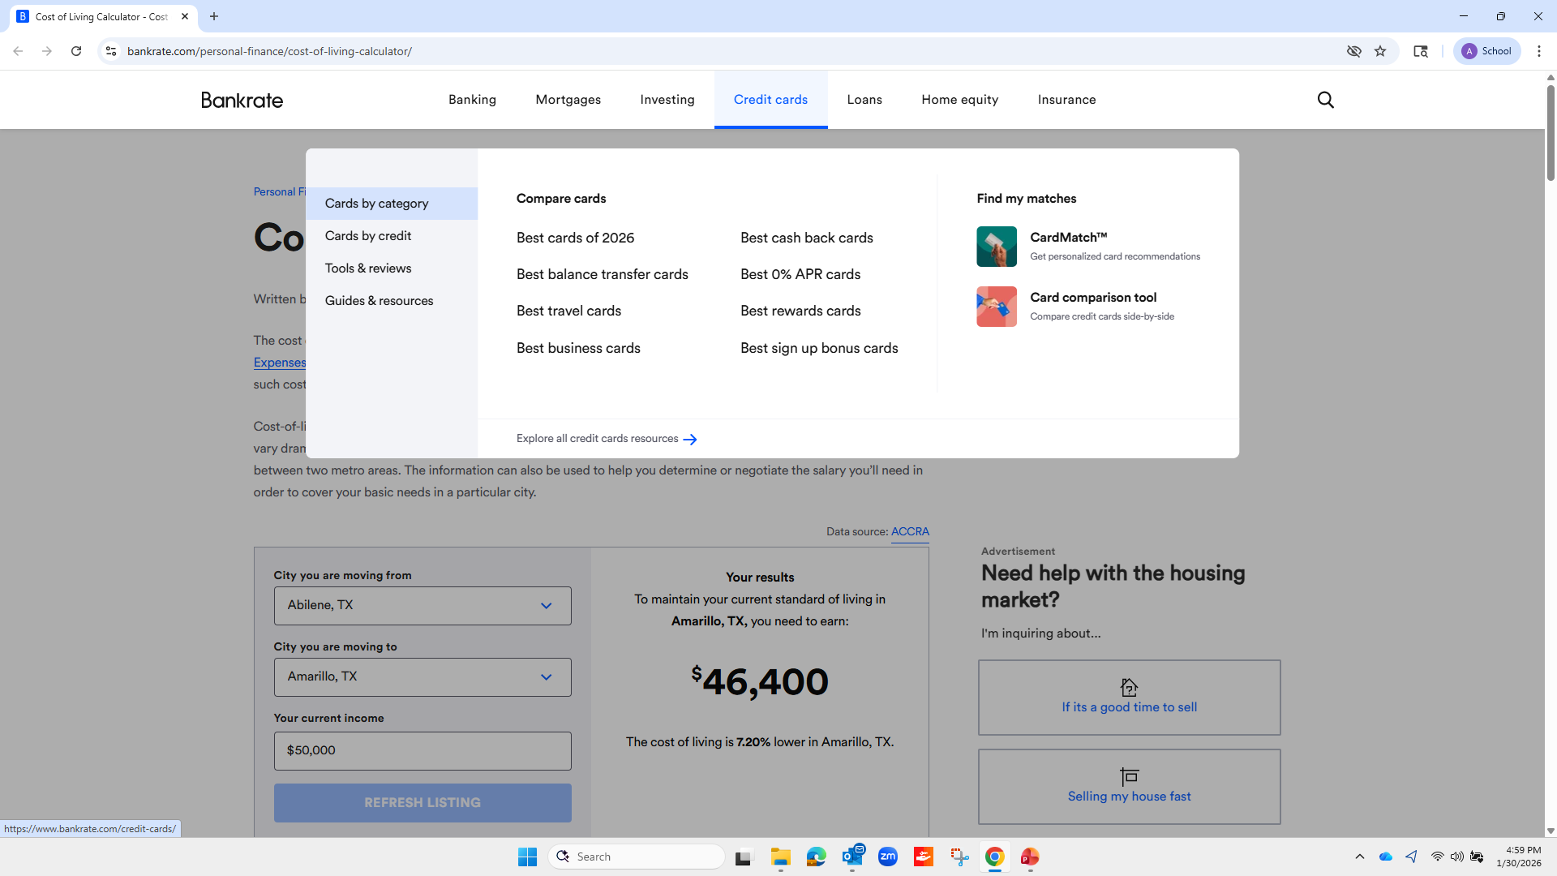
Now that you know a little bit about the renting process and the housing costs in your hometown, you may want to explore moving to another city where there are other job prospects. Go to this site and compare the cost of moving from where you currently live to another city. Include the costs of housing and utilities, along with other household expenses, to compare the differences in living expenses in different places around the country.
Click
Relocation
Cost of Living Calculator

Slide 29

Renter’s Insurance
Renter’s insurance is something your will want to purchase as soon as you move into your new home or apartment. It is relatively inexpensive but priceless if disaster should happen to strike. Your landlord is responsible for maintaining the structure but any of the contents that belong to you, like your furniture, electronics, dishes, linens, and decorative items, would all be your responsibility to replace if something happened like a fire, flood, or robbery. Policies can cost as little as $12 a month. Many insurance companies who insure your vehicle can also insure your possessions and give you a discount. Rental insurance rates fluctuate based upon location due to crime rates and environmental risks, total value of your belongings, building age, and scope of coverage. The average renter has $25,000 worth of “stuff”.

Slide 30
Helpful Websites
Apartment affordability calculator http://www.myapartmentmap.com/affordable_housing/calculator/
Rent calculator http://firstapartmentguide.com/rent-calculator
HUD https://www.hud.gov/topics/rental_assistance
http://www.realtor.com/mortgage/tools/rent-or-buy-calculator
http://www.city-data.com/housing/houses-Athens-Tennessee.html
http://www.city-data.com
http://www.city-data.com/housing/houses-Athens-Tennessee.html

Slide 31
In summary, you should put a lot of time and thought into deciding your housing needs and what you can afford. Be sure to read all the fine print before signing on the dotted line for your lease!

Slide 32

Ann A. Berry, Ph.D.
Assistant Department Head, Professor & Consumer Economics Specialist
Department of Family & Consumer Sciences
February 2026
The University of Tennessee Extension offers its programs to all eligible persons regardless of race, color, national origin, sex, age or disability and is an Equal Opportunity Employer.

