Slide 1
ACTIVITIES

Slide 2
Introductory Activity

Slide 3
Meet and Greet

Slide 4
Prep:
Using a set of questions and answers, prepare 2 x 4 labels with either a question or an answer that can be matched. Make sure you know how many participants you have and make sure you have one matched set of question and answer for each 2 participants. Cut labels apart and place in a basket, bowl, or pile randomly mixed together.
Activity:
Everyone chooses a label (“nametag”) on the way in the door. Note: Nametags in this activity have no names only questions or answers. Instruct participants to choose and have a seat. Then explain that the group will try to find the match to the label they chose. Give the group time to find the match and introduce themselves to that person.

Slide 5
Vocabulary Activities

Slide 6
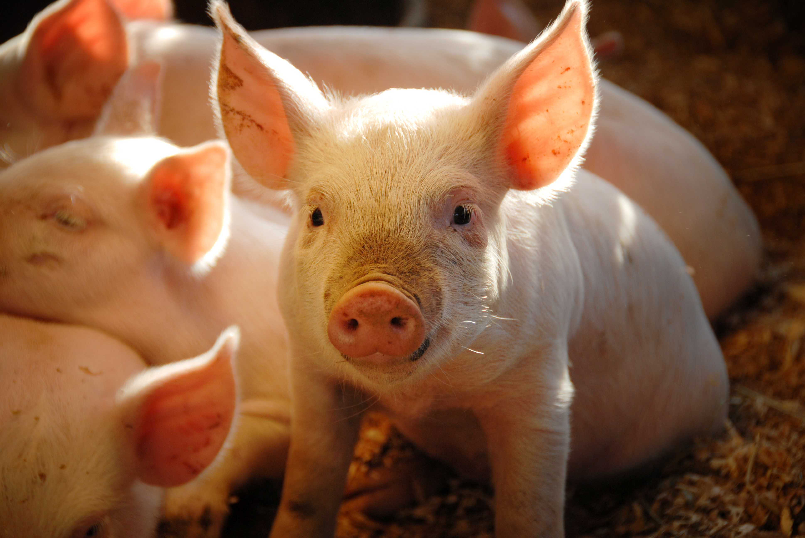
Piggy
Pass

Slide 7
Activity:
Ask participants to stand in a circle.
Explain that only financial or consumer economic terms may be used (filler terms like money and penny may also be used if you wish).
Start the activity by saying a vocabulary word while holding the plush pig. Pass the pig to the person to the right (counterclockwise) and explain that participant must come up with another word that begins with the last letter of the previous word.
For example, if you have given the word financial the next person in the circle should use a word beginning with L like loan. Once successful, that participant would then pass the pig (again to the right) and the next person might say notary.
The activity continues like this until someone must pass because they cannot think of a word. Everyone has one pass. At the point which a player has passed and cannot think of a word a second time they are out of the game.
Play continues with the rest of the group until there is only one person left.

Slide 8
Tic-
Tac-
Toe

Slide 9
Activity:
Divide class into groups of 5 or less, if possible. Make sure to have an even number of groups/teams. Manipulate the numbers to give you an even number of groups. Post a tic tac toe board on whiteboard, post-it or other surface for every two teams. If you have more than two teams, you may want to have help facilitating.
Flip a coin or choose a number to determine which team goes first. Ask a question and if they get the correct answer, they may place their choice of x or o where they like. If the answer is incorrect, offer the chance to answer to the other team. Continue in this way until there is a tic tac toe or the board is full.

Slide 10
Tic-
Tac-
Toe
ADVANCED

Slide 11
Activity:
Ask a question from the set of review questions and allow teams to “buzz in” with the device you have chosen for this purpose (buzzer, bell, etc.). If the first team answers correctly they will have the opportunity to place a 3 x 3 sticky note on one of the tic tac toe boards to “start” that board. If they are incorrect, the other team has the chance to answer and place a sticky note.
Ask the second question. This time the team that answers correctly will be able to place a sticky note on a different board to “start” that board. All 3 boards must be started in this way before tic-tac-toe can begin.
After the third question, and all the boards are started, players may place their sticky note on any board and in any placement with the goal of winning the tic-tac-toe on the board. Rules are the same as tic-tac-toe in that only completed rows (horizontal, vertical, or diagonal of three like colors) will win. The team goal is to win two of the three boards.
If there is no winner on a board a tie breaker question should be asked.

Slide 12
Financial
ro ss
word

Slide 13
Instruction:
Briefly review the vocabulary to address.
Break students into groups and provide paper, poster board or other writing area you want them to use.
Tell students they will create a large crossword by choosing a starting word to build from (you may want to hint that longer words work best).
Explain that each word must touch another word and in each place the words touch it must make another word. There can be spaces between letters, however.
For example:
Crosswords may look like this:
Or this:
To ensure participation, each student is given a different color marker with the requirement that everyone contribute to the crossword. A quick visual check will help confirm that all group members have written something.
Students can be given an unlimited amount of time, or the activity can be time limited.

Slide 14
Review Activity

Slide 15
Target Practice

Slide 16
Investment Pyramid | Annuities | Futures | Savings | Net Worth
Bonds | Financial Records | Low risk | Life Insurance | Risk Meter
Medium risk | Contracts | 401K/ 403B | Collectibles | Property and Liability Insurance
Diversification | Risk tolerance | Health Insurance | IRA | Mutual funds
Disability Insurance | Stocks | Goals | Budget | High risk

Slide 17
Other Activities

Slide 18
life
work
B a l a n c e

Slide 19
Activity:
Ask participants to think about things they enjoy doing. What is it you love to do? Could you be happy without doing this? Ask participants to identify an activity. There is no discussion at this point. Only pose the questions then send participants to whiteboards or sticky sheets and have them write down the activity they identified.
After everyone has written, open a discussion using questions similar to the following. What is your favorite pastime, hobby, or activity? How important is this activity to you?
Allow everyone to take part in the discussion.
After everyone has had a chance to participate, ask participants if these activities have a cost. Some activities will have obvious costs. For example, any kind of art or crafting involves costs for supplies. However, other activities may have a cost that is less obvious such as hanging out with friends.
Pair students and have them brainstorm and write down the perceived costs associated with the activities each of them listed. Ask participants to share out.

Slide 20
After discussion, pose the following questions, Did you consider your time as a cost? What does your time cost you? Allow for answers. Ask, If you are giving time to one thing does that mean you are missing another opportunity to use your time?
Introduce and explain the concept of opportunity cost. A succinct definition of opportunity cost is the value of the decision not made. Any decision requires that an alternate decision was rejected. Opportunity cost is the cost of what was given up or passed by.
Ask participants to consider the opportunity costs for the activities they enjoy.
Using the computer, direct students to research their activity and write down some real costs for what they like to do, be sure they also include the cost of their time or opportunity cost when writing.
Ask questions similar to the following. Considering the cost of your favorite activities, how do you make plans to do these things and include them in your life? Is it important to include these things? Open a discussion about work-life balance.

Slide 21
Question Bank

Slide 22
Credit | Saving | General | Insurance
What is a credit score? | What does PYF stand for? | This is the value of all your assets. | What does liability insurance cover?
A credit score is a prediction of your credit behavior, such as how likely you are to pay a loan back on time, based on information from your credit reports. | Pay Yourself First. Put money into savings as soon as you receive your check. | Net worth | Damage to someone else's property.

Slide 23
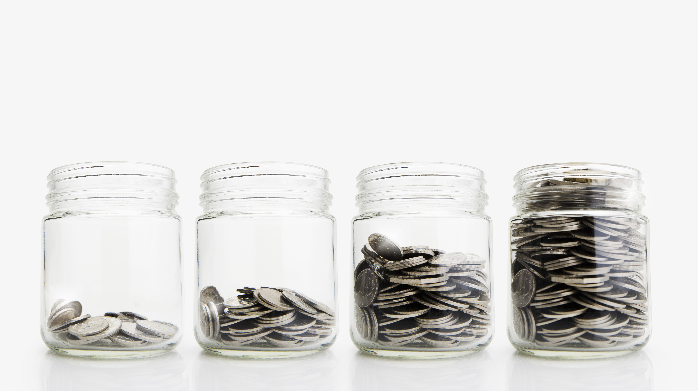
Thank you!

