Slide 1

Keeping a Roof Over Your Head
Notes:
Providing a place to live, along with the expenses that go along with it, can take a big portion of your paycheck. Deciding the best housing option for you is critical to making the most affordable and the healthiest housing choice.
Having a safe, comfortable, affordable place to live helps you be healthier, both physically and emotionally. This unit will discuss various housing options, their costs and benefits, and issues that you may encounter when shopping for housing.

Slide 2
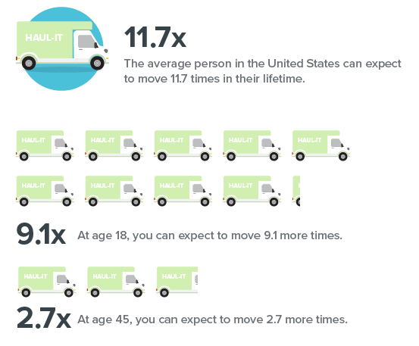
On the Move
When you think you are ready to purchase a home,
consider attending a first-time Homebuyer
Education Class taught by a UT Extension agent in
your area before you begin the mortgage process.
Notes:
Data from Nasdaq.com December 2023, Forbes, and movingfeedback.com.
People tend to move a lot during a lifetime. Most
of you are just starting out on your own, but at age 18
you can expect to move at least 9 more times! It is
estimated that it costs $2,300 (less than 100 miles) to move locally. For a long-distance move, it could cost between $4,300 and $5.500. To make the best decisions for those
9+ moves, there are some basics you need to know
before beginning your housing search.
In this lesson we are going to focus on the things you need to consider when renting a place to live rather than
purchasing a home. We will also discuss, however, the
advantages and disadvantages of both buying and
renting.

Slide 3

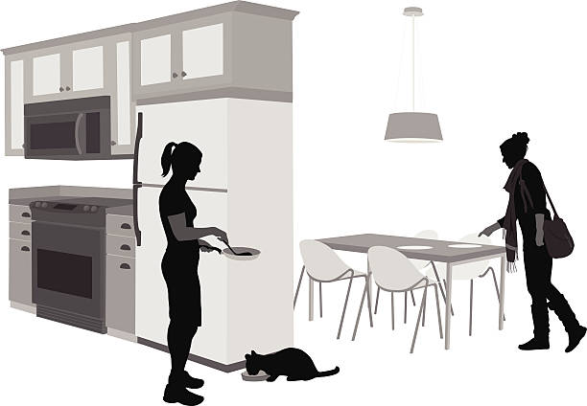
Key questions you need to consider whether you want to rent or own:
Will you be staying in your hometown?
Are you moving to go to college?
Are you moving to start a new job?
Will you be living with a roommate?
Do you have pets?
Do you have money set aside for
moving expenses?
Notes:
Finding a place to live that fits your budget and lifestyle is very important at any stage of your life. When you are first starting out, your housing options may be limited−by your budget or by where you live and what is available.

Slide 4
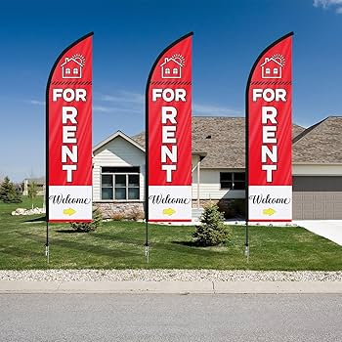
You can visit this website to compare the cost of buying vs renting:
http://www.realtor.com/mortgage/tools/rent-or-buy-calculator/
Purchase
Enough money for the down payment
Good credit score (640 minimum)
A steady job
Plan to be in location at least 5 years
Rent
New job?
Not sure how long will be in area?
Poor credit?
Little or no savings?
Notes:
Purchasing a home requires commitment to save money for a down payment and closing costs. Most lenders require 20% of the total loan amount for the down payment. Also, a good credit history with a good credit score is required to get the best mortgage rates. THDA (Tennessee Housing Development Agency) offers loans to first-time homebuyers and they require a minimum credit score of 640. Lenders want to see that you have steady employment, too.
Renting might be the better option if you are just starting out working and don’t know how long you plan to be in the area. If you are not sure of your future plans, homeownership may not be your best option right now, so you should consider renting. Many rental companies must run a credit check on you before renting to you. Even renting a house or apartment will require you have some money saved up for moving expenses. We will go into those in detail.

Slide 5


Pros & Cons of Buying
Potential Advantages
Potential Disadvantages
Typically increases in value over time.
Home equity can be used to help with future financial goals.
Pride in ownership.
You control the décor and remodeling.
Tax deductions.
A long-term financial commitment.
You must perform maintenance and make all repairs.
Requires a considerable amount of money for the down payment, closing costs, and moving expenses.
Can be difficult to sell quickly if you need to move.

Slide 6
Pros & Cons of Renting
Potential Advantages
Potential Disadvantages
Short-term commitment: Easier to move on short notice than if you were purchasing your home.
The landlord is responsible for repairs and maintenance.
While they can be expensive, move-in deposits are lower than the down payment and closing costs involved in purchasing a home.
You are not building any equity while paying rent.
No tax advantages.
Rent will probably increase from year to year.
May have restrictions on noise, pets, guests, etc.

Slide 7
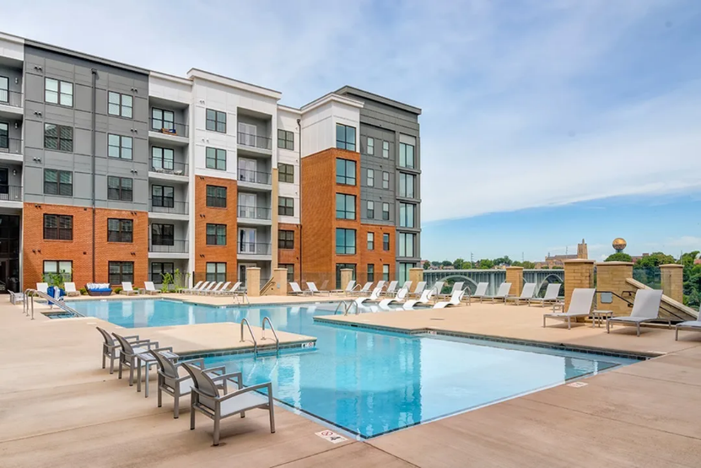
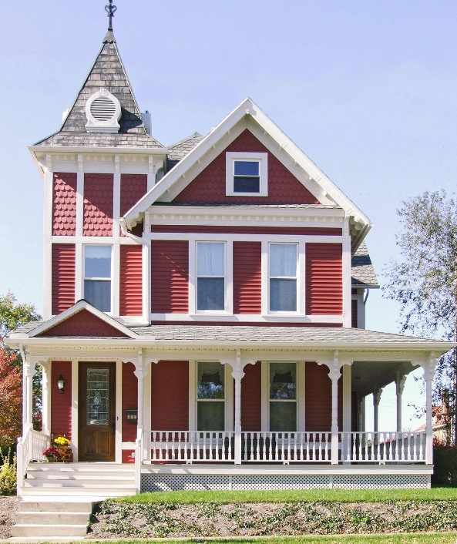
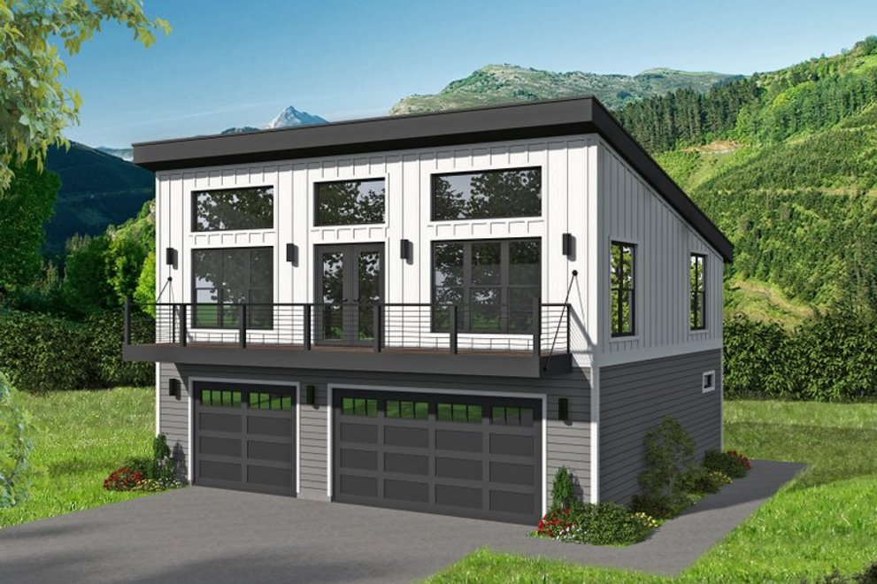
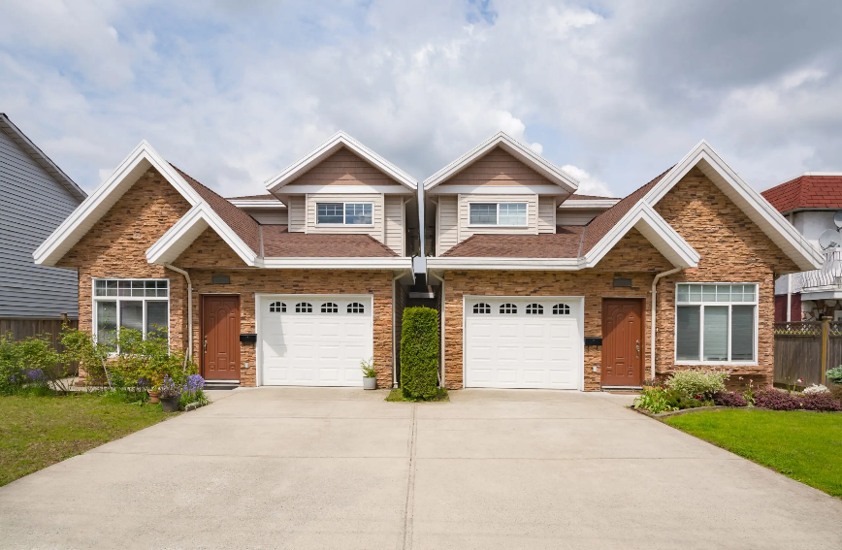
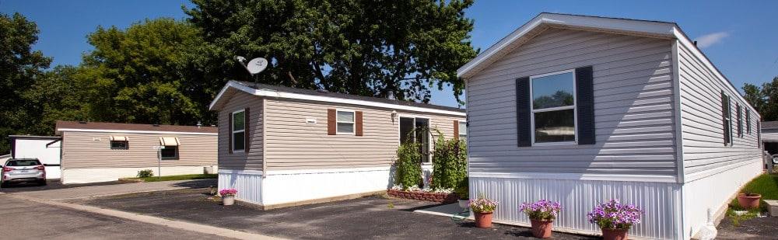
Notes:
Garage apartments, large apartment complexes with pools and workout rooms, trailers, duplexes, and
single-family homes can all be choices available to rent (depending on the area) to keep a roof over your head.

Slide 8
Pros & Cons of Renting an Apartment
Potential advantages
Potential disadvantages
Secure and private entry to the building.
Greater chance of responsive landlord or property manager.
May have a pool or workout area.
Shared space with all other residents—laundry rooms, etc.
May have noise issues.
Pets may not be allowed (or require a large additional security deposit).

Slide 9
Pros & Cons of Renting a House
Potential advantages
Potential disadvantages
Typically more room than an apartment.
May be able to share with several roommates and reduce expenses.
Better possibility that pets will be allowed.
More likely to have private clothes washer/dryer.
May not be as safe or secure as an apartment, depending upon location and type of structure.
May require more maintenance.
The nicer the house and the fewer roommates you have, the more it will cost.

Slide 10
Choosing Your Home
Other things to consider:
Location—close to your job, things to do.
Safety of the neighborhood.
Your space needs (how many bedrooms/bathrooms?).
Will you have roommates or family members?
Do you have pets? If so, will they need a yard?
Notes:
We are going to focus on renting for the rest of this lesson. Your rental options can vary depending upon where you live. What type of housing you can afford and what type of living environment you desire all come into play when selecting your home.

Slide 11

Costs of Keeping a
Roof over Your Head
Rentcafe.com March 2025
Average cost for 2-bedroom apartment:
US $1,356
Tennessee $1,513
Monthly rent and utilities—no more than 30% of your net pay
Notes:
According to Rentcafe.com, the average cost of renting a 2-bedroom apartment in the US in March 2025 was $1,356. In Tennessee, the average cost was $1,513. Of course, these are averages, so the cost can vary widely by location.
Your rent will probably take the largest portion of your paycheck, so making your saving/spending plan with a rent amount that you can live comfortably with is critical. Ideally, your monthly rent and utilities should take no more than 30% of your monthly net (after tax) income. Some say 30% of gross, but try to keep this for your net pay.

Slide 12


Costs of Moving
First and last month’s rent
Security deposit (TN does not limit the amount)
Pet deposit
Holding fees
Utility deposits
Moving costs (~$4,600)−unless you have friends with a truck!
Furniture
Notes:
There will be some costs that you will need to be prepared to pay up front. Usually landlords will require certain deposits, and you will also have to think about other deposits and costs. The average moving cost for a professional mover is $4600.

Slide 13
Housing Costs (and other cool facts) for your town
http://www.city-data.com
Notes:
Find your city and check out the housing costs. This can give you an idea of how to budget for housing costs when looking for a place to live.

Slide 14
Athens
Median monthly housing costs $852
Median gross rent $873
Median price for vacant home for sale $110,928
http://www.city-data.com/housing/houses-Athens-Tennessee.html *use this link to complete the assignment in your Study Guide!!
Notes:
Costs for 2023

Slide 15

Landlord Rights & Responsibilities
Landlord Rights
Right to collect rent and prearranged late fees for overdue payment.
Right to raise your rent according to your lease.
Right to evict.
May enter the dwelling without consent in the event of an emergency.
Landlord Responsibilities
Keep the property safe and in good repair.
Do not discriminate. (Tenants are covered by the Fair Housing Act.)
Working smoke alarms.
Notes:
When you rent a place to live, you need to get the agreement in writing. This written agreement is called a lease. The lease should state both the rights and duties of both you and the landlord.

Slide 16

Tenant Rights & Responsibilities
Tenant Rights
The right to a “quiet environment.”
You cannot be discriminated against because of your race, color, nationality, sex, or religion.
Heating and air conditioning must work.
Toilets and water heater must work.
Door locks must work.
Roof must be in good condition (no leaks).
Appliances that are supplied (refrigerator, stove) must be working.
Tenant Responsibilities
You must pay your rent on time.
You must obey the lease agreement.
You must obey all building and housing codes that materially affect health and safety.
You must not disturb your neighbors or allow your guests to disturb neighbors.
When you leave, the place should only have signs of normal use−no damage.
Be sure to read your lease closely, as there may be other duties required when you move out, such as mowing the grass.
You must let your landlord come in at reasonable times to inspect the space, make repairs, perform pest control, etc.
You must not engage in any illegal activity on the premises.
Maintain the property in a clean and habitable condition.

Slide 17
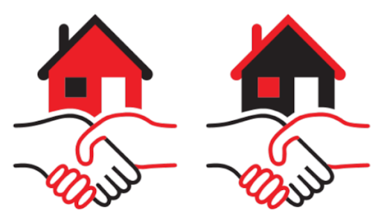
Types of Leases
Short-term lease: Fixed monthly rental rate for the entire duration of the lease (6 months is typical).
Month-to-month lease: You agree to rent for one month at a time. This can be more expensive. Your rental price could change at any time (with sufficient notice by your landlord). If you are unsure of how long you will be in the area or just need a place for a limited time, this might be a good option. The landlord may cancel the lease by giving you 30 days’ notice.
Subleasing (a.k.a. “subletting”): Subleasing is renting under an original lease that someone else holds. Normally, you work out arrangements with the original tenant rather than the landlord, but be sure to obtain written consent from the landlord allowing you to live in the house/apartment.
One-year lease: Easiest lease to find and the standard. Protected against rent increases for the duration of the lease.
Notes:
A lease is a legal agreement between you and a landlord. Leases obligate you and your landlord to specific commitments. You may need a co-signer if you are under a certain age or don’t have much credit history.
Once you find that perfect place to live at the monthly rent you can afford, the length of time you plan to obligate yourself to renting the apartment/home is critical. The lease obligates you to rent the place for a certain amount of time and the landlord to rent it to you for that length of time at that price. If you decide to leave before the lease is up, you are responsible for any of the remaining rent you owe for the time remaining on the lease.
Generally, the longer you agree to rent a place, the cheaper your rent will be.

Slide 18
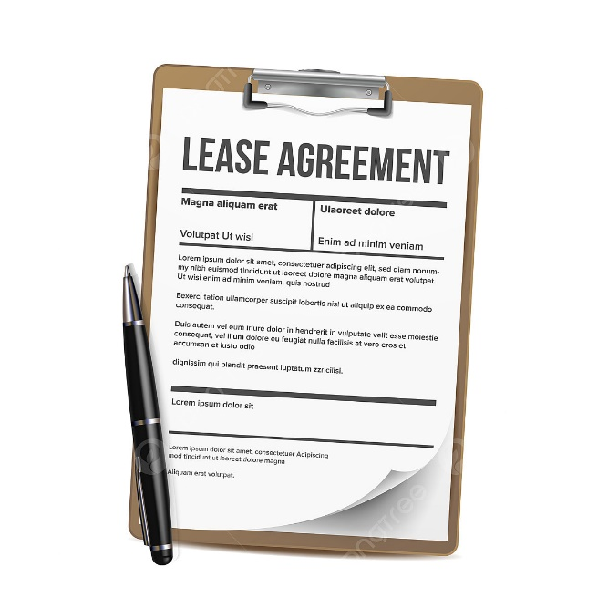
What to look for in a lease
Address of the place you are renting.
Address and phone number of landlord.
The rent amount ($).
The length of the lease.
When rent must be paid (each month’s due date).
How many occupants are allowed.
Parking rules/restrictions.
If pets are okay. If so, size, kind, and any extra deposit required.
Late fees for late rent payment.
How much the security deposit is and when the landlord can keep it.
Who pays for the electricity, gas, water, garbage, cable, etc.
When you or the landlord can end the lease.
When the landlord can come into your place without your permission.

Slide 19

More about Leases and Security Deposits
Do not sign a lease that has blank spaces.
Get a signed copy and put it in a safe place. Everyone should sign it: you, the landlord, and anyone else who will be a renter.
The amount of the rent and when it is due should be agreed upon and included in the written lease agreement.
Always get a rent payment receipt and keep them in a safe place.
The security deposit pays for any damage you may cause beyond normal wear and tear. Get a receipt for the security deposit signed by the landlord that clearly states it was for the security deposit, the amount paid, and the date. Tennessee has no limits on how much landlords can charge for security deposits.
Before you move in make a list of anything wrong with the dwelling (and take dated photos, if possible). Then you cannot be charged for that damage when you move out. You should review this list with the landlord before you both sign it.
When you move you should get your entire security deposit IF . . .
you don’t owe any rent,
you have not damaged the property, and
you have not broken the lease.
Don’t wait too long to ask for your deposit back. Ask for it in writing and give your new mailing address.
Your landlord can keep your security deposit if you abandon your home. Your home is considered “abandoned” if . . .
1. You are behind on rent and leave for 30 days or more without giving a legitimate reason, OR
2. Your rent is 15 days late AND it looks like you have left the rental for good.
If you abandon your home, the landlord can rent it to someone else. He can also sell anything you left behind.

Slide 20

When you can’t pay rent
Most landlords will not evict you if you are a bit late paying your rent,
although you will probably be charged a late fee. If you find, however, that
you cannot pay your rent, or your income is drastically reduced, you need to be
proactive and contact your landlord as soon as you know you are having difficulty.
Ask to negotiate a late payment in advance of your payment date.
Offer to pay at least some of the rent by the due date.
Explain your circumstances and how you expect to resolve them so that your rent will be on time in the future.

Slide 21
Click
Relocation
Cost of Living Calculator
Notes:
Now that you know a bit more about the renting process, you may want to think about moving to another city where there are other job prospects.

Slide 22

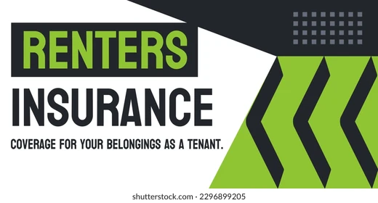
Determine how much your personal stuff is worth:
https://www.shelterinsurance.com/insurance/rentersinsurance/personalpropertycalculator/
Renter’s Insurance
Notes:
Renter’s insurance is something you will want to purchase as soon as you move into your new home. It is relatively inexpensive, but priceless if disaster strikes.
Your landlord is responsible for maintaining the structure itself, but any of the contents−like your furniture, electronics, dishes, linens, and decorative items−would all be your responsibility to replace if there were a fire, flood, or robbery. Policies protecting your belongings can cost as little as $12 per month.
Many insurance companies that insure your vehicle can also insure your possessions and give you a discount. Rental insurance rates fluctuate based upon location, due to crime rates, environmental risks, the total value of your belongings, building age, and scope of coverage. The average
renter has $25,000 worth of “stuff.”
https://www.shelterinsurance.com/insurance/rentersinsurance/personalpropertycalculator/

Slide 23
Helpful Websites
Southeast Legal Aid
http://www.selegal.org/leases.htm
Legal Aid Society (TN)
www.las.org
Apartment affordability calculator http://www.myapartmentmap.com/affordable_housing/calculator/
Rent calculators
http://firstapartmentguide.com/rent-calculator
http://www.realtor.com/mortgage/tools/rent-or-buy-calculator
U.S. Dept. of Housing & Urban Development (HUD)
https://www.hud.gov/topics/rental_assistance

Slide 24


Notes:
In summary, you should put a lot of time and thought into deciding your housing needs and what you can afford. And be sure to read all the fine print before signing on the dotted line for your lease!

Slide 25
Ann A. Berry, Ph.D.
Professor
Consumer Economics
Department of Family & Consumer Sciences
May 2025
The University of Tennessee Extension offers its programs to all eligible persons regardless of race, color, national origin, sex, age, or disability, and is an Equal Opportunity Employer.

