Slide 1

Lifestyle Factors In Improving Immunity
2022 Leader Lesson
Tennessee Association for Family and Community Health
Soghra Jarvandi, MD, MPH, PhD
Community Health

Slide 2

Immune System
Every day, your body is exposed to germs.
Immune system is a complex system that helps you stay healthy.

Slide 3
Immune Response
Everyone’s immune system responds differently to germs, based on several factors listed here:
Age
Genetics
Vaccination
Medications
Diet
Physical activity
Sleep
Stress
Smoking
Gut health

Slide 4
Healthy Lifestyle to Increase Immunity
Don’t Smoke
Eat Healthy
Be physically active
Get Enough Sleep
Practice Relaxation
Limit Alcohol

Slide 5
Healthy Diet
Diet
Immune Function
Vit. A
Vit. E
Vit. C
Vit. D
Zn
Fe
Cu
Vit. B12
Vit. B6
Vit. B9
Folic Acid
Mg
Several vitamins and minerals are required for immune function

Slide 6

VITAMIN D - Sunlight
Sunlight
Important source of vitamin D
The body uses sunlight to make vitamin D
Too much sun exposure is harmful.
  Use sunscreen with a sun protection factor (SPF) of ≥15 when you are outdoors.

Slide 7

VITAMIN D - Food
Natural
Foods with the highest amount of vitamin D
  Fatty fish (trout, salmon, tuna and mackerel)
Other foods sources of vitamin D
  Beef liver, cheese and egg yolks
Fortified
Milk and plant milk alternatives (such as soy milk)
Infant formula
Breakfast cereals
Some brands of orange juice and yogurt

Slide 8

VITAMIN D - Supplement
  Should I take a vitamin D supplement?
  Talk to your healthcare provider to see if you might need to take a vitamin D supplement. They check the levels of vitamin D in your blood
  Is too much vitamin D harmful?
  Yes. Vitamin D is fat soluble, meaning that the extra amounts are stored in the body and can reach toxic levels if taken excessively.
Read the labels carefully

Slide 9
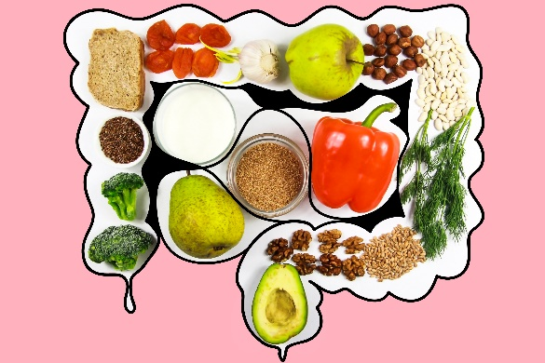
Gut Health
To improve gut health:
Make a greater portion of your diet whole plant foods like fruits and vegetables, whole grains and legumes.
Avoid highly processed foods like potato chips, cookies and lunch meats.
Limit intake of high-fat animal products and added sugars.
Be physically active.
Manage stress.

Slide 10

Sleep
Quantity and Quality
14-17
hours/day
Newborns
12-16
hours/day
Infants
10-14
hours/day
Toddlers
8-12
hours/day
7-8
hours/day
Preteens/Teens
Adults
National Sleep Foundation and American Academy of Sleep Medicine
Notes:
These are average

Slide 11
Resource and Additional Reading
Healthy Living Guide, Harvard University

Slide 12
Thank You!

