Slide 1
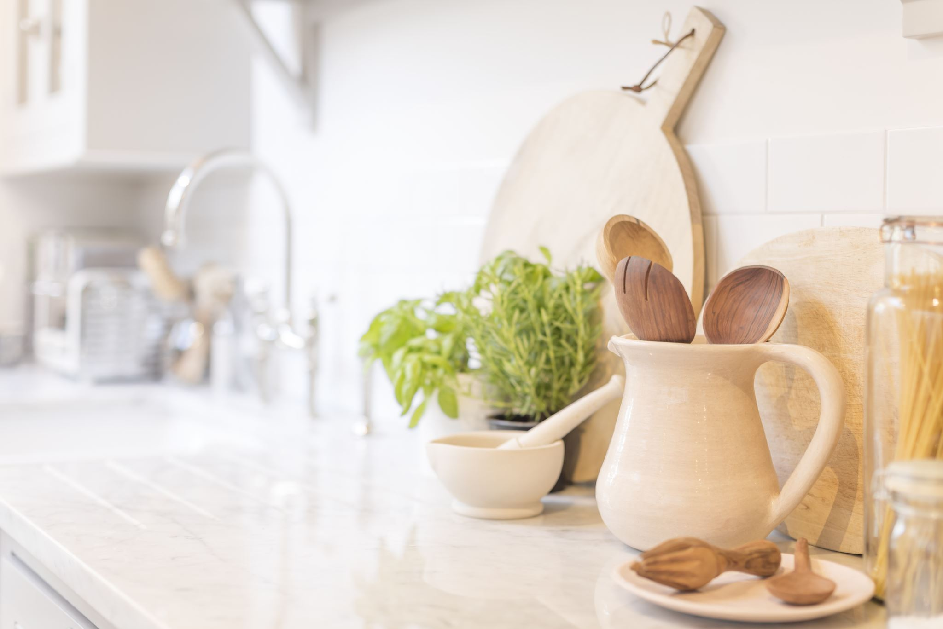
Cooking for One or Two
2023 Family and Community Education (FCE) Leader Lesson
Prepared by: Kristen Johnson, PhD, RDN
Assistant Professor and Nutrition Specialist
Notes:
Welcome participants and introduce yourself.
Ask: “Has anyone been in a situation where you needed to prepare a meal for one or two people? Was it easy for you to find recipes or prepare a meal for one or two?
Say: “Whether you prepare meals for one to two people regularly or only once in a while, it can sometimes feel challenging to cook for a smaller crowd, especially if you’re used to cooking for a large group of people! Sometimes, it can even feel like cooking for one to two people isn’t worth the effort.
Ask: “Has anyone ever felt that way?
Say: In today’s lesson, we will discuss tips and techniques that can help us prepare nutritious meals for one to two people.

Slide 2
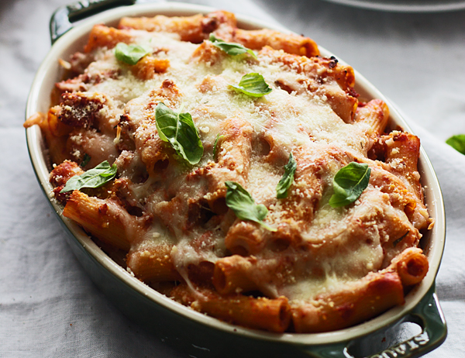
Make meals enjoyable
Plan meals
Theme nights
Recipe or meal swaps
Try something new!
Create a welcoming eating space
This Photo by Unknown author is licensed under CC BY.
Notes:
Whether you’re planning meals for yourself, a small group, or a large group, finding ways to make meals enjoyable for your self and your dining companions is important! Let's talk about a few ideas that might help keep our mealtimes enjoyable.
Deciding what to prepare and serve for meals each day can sometimes feel overwhelming and stressful. Sometimes, it can feel like you prepare the same dishes over and over again. Has anyone ever felt that way?
Like many things we do, taking time to plan, usually makes the task easier and less stressful. This is true for cooking too! Whether you're cooking for yourself or for a group of any size, taking time to plan the meals you will serve over the next week (or another time-frame that works for you), can help make the process less overwhelming and stressful. Meal planning also helps make grocery shopping less stressful and can save you money too!
You can make your meal planning as simple or as detailed as you prefer. You may want to start with writing down the dinners you plan to serve during the next week, or you may prefer to plan the meals you'll serve for breakfast, lunch, and dinner during the upcoming week.
While you're planning meals, consider some ways to add excitement to mealtime and your eating routine. Some ideas are:
Incorporating theme nights into your eating routine. Perhaps you have breakfast for dinner one night, soup on Tuesday nights, and Pizza on Fridays.
Swapping recipes, dishes, or meals with your friends, family, and other people in your life. You might share recipes you enjoy or take turns preparing dishes or meals that you eat together or bring to each other.
Finding new recipes to enjoy. Meal planning is a great time to find new recipes to incorporate into your routine. You might research foods from a different culture and learn a new recipe. Or find a recipe to prepare a new dish or a new food that you've been wanting to try. Or you might find a new way to prepare a favorite dish or use a favorite food.
Another important step to make mealtimes enjoyable is to create an eating space that you find comfortable and welcoming and where you can focus on and enjoy the smells, tastes, and textures of your meals. You may find that setting the table with a pretty table cloth, adding candles, choosing your favorite dinner ware, playing music, or even listening to TV make mealtimes enjoyable. Whether it's an elegant table setting or a cozy, casual spot in your home, find a spot to enjoy your meals – a place where you feel comfortable and you can focus and enjoy your meals.
Keep in mind that the steps we take to make mealtimes enjoyable will likely be different for each of us! What I found enjoyable might not be the same things that you find enjoyable! The steps we take to make mealtimes enjoyable may vary for each of us at different times, as well. There may be times when preparing an elaborate meal is enjoyable, while at other times, choosing something simple and quick my be a better option for you.
Ask: "Would anyone mind sharing some of the strategies you currently use, or you would like to try, to make mealtimes enjoyable?"

Slide 3
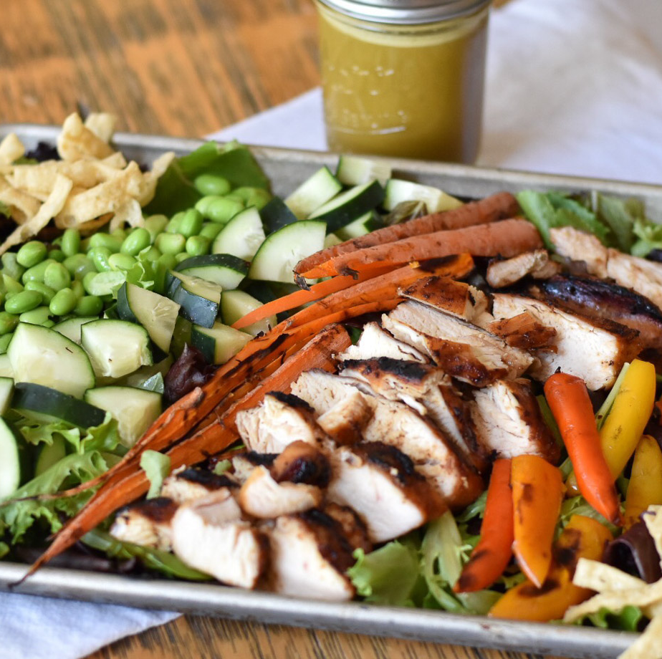
Leftovers and Planned Overs
Plan to use leftovers within 3-4 days
Repurpose leftovers into planned overs!
Refrigerate or freeze perishable foods within two hours after preparation or removing them from the refrigerator or freezer.
Reheat leftovers to 165 F
This Photo by Unknown author is licensed under CC BY-NC-ND.
Notes:
Leftovers and "planned overs" can be especially helpful when you're cooking for yourself or a smaller group. Many recipes are written to serve more than one or two people, so finding ways to use leftovers can help you save time and money and keep you from throwing out good food!
As you are planning your meals, think about ways that you can incorporate leftovers into your meal plan. It may be that you plan to reheat the same dish and enjoy it later in the week. You may also think of ways to repurpose your leftovers into "planned overs" - by incorporating those leftovers into a new dish.
Here are a few examples:
If you plan to serve roast chicken for dinner, you could also plan to use the leftover chicken later in the week by adding it to a soup, a casserole, or serving it on top of a salad.
If you serve chili one night, plan to use the leftover chili as a topping for a baked potato or a sauce for pasta later in the week.
If you prepare a vegetable beef soup, chop extra vegetables that you can use on salad for lunch or dinner later in the week.
Leftovers and planned overs are a great way to save time and money, but we do want to make sure we handle leftovers safely so that they remain safe to eat. Some of the important steps to remember are:
1. Use leftovers within 3-4 days. As you're planning your meals, include leftovers in your meal plan, but make sure they will be used within 4 days.
2. Refrigerate or freeze perishable foods within two hours (or one hour if the temperature is above 90 F) of their preparation or from removing them from the refrigerator or freezer because bacteria that can cause illness grow rapidly at room temperature.l
3. If you are reheating leftovers, use a food thermometer to make sure the food is warmed to at least 165 F.
Ask: “What are some ways that you use leftovers?”

Slide 4
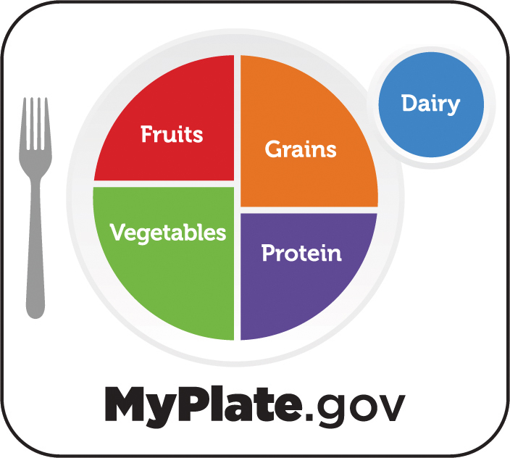
Nutrition
Choose foods with nutrients your body needs
Include foods from all the food groups
Notes:
As you're planning meals, aim to include the foods that fuel our body and give us the nutrients we need to be our best and do the things we need and want to do. Aim to include a variety of fruits and vegetables, dairy products, whole grains, fish and seafood, beans and peas, nuts and seeds, and other lean protein foods like meat and poultry. All of these foods give us different types of nutrients that our bodies need to work their best.
You've probably seen MyPlate, which can help you plan meals and snacks that include the different types of foods our bodies need.

Slide 5
Single Serve and Convenience Options
Compare prices
Balance convenience with cost and nutrition
Look for foods that offer vitamins, minerals, fiber, and other nutrients
Check the Nutrition Facts Label to compare sodium and other nutrients
Find the best option for you
Notes:
You've likely seen many options in food stores that are designed to make meals faster, easier, and more convenient. Whether it's a frozen or refrigerated pre-prepared meals, chopped produce items, or foods, like canned fruits and vegetables or rice that are , sold in individual or smaller sized packages, these products offer convenience and can save time, especially when you're cooking for one or two people.
Sometimes, convenience foods can come with a higher price and can sometimes have higher amounts of sodium, saturated fats, or added sugars and offer fewer vitamins, minerals, fiber, and other nutrients as compared to other foods. To help make a choice that's right for you -
1. Compare prices. Use the unit price to help you compare brands and product sizes. Compare prices of products that are sold in individual size packages vs. Those sold in larger amounts.
2. Consider your budget, your storage space, and the amount of the food you need and will use before it spoils to find the best choice for you. If the largest package size is a better deal, you have the room to store the food, and you will use it or freeze it before it spoils, that might be a good option for you. But if you won't use or can't store the food before it spoils, a smaller package may be a better option for you.
3. As you make your food choices, remember to balance convenience with cost and nutrition. Pre-sliced produce packaged small portions are often more expensive. You might ask yourself if these items will help you incorporate fruits and vegetable into your snacks, or make it more likely that you will prepare meals for yourself at home? If so, and these options fit in your food budget, they may be a good choice for you. Remember that canned and frozen options are good choices and can save time chopping and preparing many food items. To reduce sodium and added sugars, look for "low sodium" or "no sodium added" canned vegetables and canned fruits that are packed in 100% juice or water. Rinsing and draining canned vegetables can help reduce sodium even more.
4. Remember to look for ways to incorporate the foods that give us vitamins, minerals, fiber, and other nutrients into your meal. If you're considering a dish that is pre-prepared, like a frozen meal, look for options that include fruits, vegetables, whole grains, lean proteins, and other important foods we need. For example, if you are searching for a frozen pasta dish that you heat at home, look for options that include vegetables and/or whole grain noodles. You can also think of simple ways to add fruits, vegetables, whole grains, and other nutritious foods into your overall meal. For example, if you are preparing a frozen pizza, you could add additional vegetable toppings, like olives, spinach, tomatoes, peppers, or mushrooms. Or plan to purchase a bagged salad mix and serve your pizza with a side salad.
5. The Nutrition Facts Label is a useful tool that helps you find the amount of calories and nutrients in a serving of a food or beverage. Use the Nutrition Facts Label to compare products. For example, if you are deciding which type of rice you want to purchase, you could use the Nutrition Facts Label to compare the amount of sodium, in other nutrients, for rice that is pre-cooked and packaged in individual cups, frozen rice, and rice you prepare at home on your stove. Use the nutrition information to help you decide on the best choice for you.

Slide 6
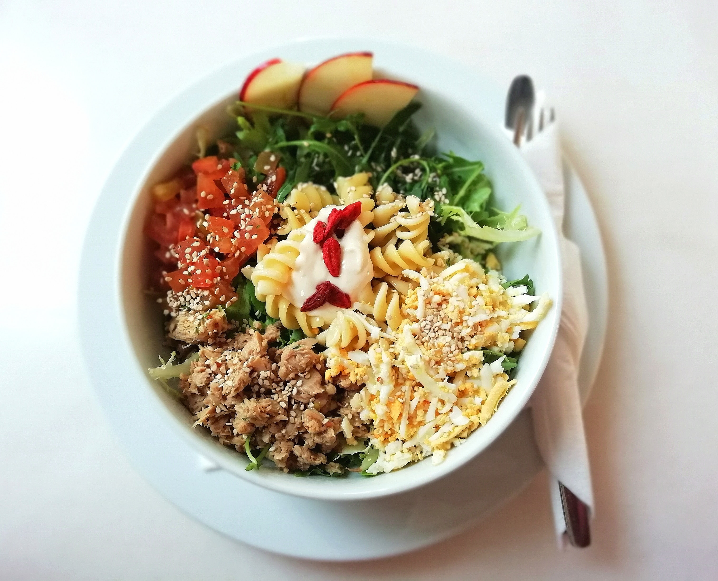
Customizable Dishes
Frittatas, omelets, and scrambles
Personal pizzas
Grain bowls
Pasta dishes
Notes:
Add dishes into your meal plan that you can easily customize to fit the amount of food you want to prepare and the foods that you have on-hand and need to use. These meals are quick, easy, and delicious options. These dishes are a great option when you are cooking for yourself or for two people dishes because leftovers can be easily incorporated into these dishes and you can easily prepare an amount that you need. Dishes like grain bowls, pasta dishes, frittatas, omelets and scrambles, and pizzas can be easily customized to fit the ingredients you have on-hand the amount of people you need to serve.
Egg dishes like frittatas, omelets, and scrambles are a delicious meal for breakfast and other times of the day. Small, oven-safe skillets are useful for preparing frittatas to serve a smaller group of people. An egg scramble is basically scrambled eggs mixed with your choice of toppings, like cheese, lean meats, vegetables, and herbs for flavor!
Personal pizzas are an easy, versatile dish that you can prepare using pizza crust, Italian bread, English muffins, flat bread, bagels, naan (a flat bread popular in Western Asian cuisines), and more! Add flavor to your pizza with your choice of sauce, cheese, and toppings for a quick and delicious meal!.
There are many ways to incorporate a variety of foods into your personal pizzas. Here are just a few examples of pizzas that incorporate toppings beyond tradtional pizza toppings:
Naan topped with hummus or tzatziki sauce, with feta cheese, cucumbers, olives, and red onions.
Tostada topped with black beans or refried beans, with shredded lettuce, tomatoes, shredded cheese, and salsa.
Let's talk more about simple steps you can use to create grain bowls...

Slide 7
Grain Bowls
Grain Base
Rice, pasta, oatmeal, grits, quinoa, couscous, etc.
Add-Ins
Fruits and Vegetables: Broccoli, corn, oranges, carrots, pineapple, radishes, etc.
Protein: Beans, meats, poultry, fish, seafood, nuts, eggs, tofu
Sauce
Marinara, pesto, salsa, guacamole, ginger dressing, vinaigrette, hot sauce, yogurt, nut butter, fruit sauce, syrup, etc.
Toppings
Cheese, chopped nuts, chopped herbs, tortilla chips, lemon, lime
Notes:
Grain bowls are great options when you're cooking for one or two because you can easily prepare the amount of grains you need, some grains, like rice, are often packaged in single or double serving packages. These dishes are also a great way to incorporate leftovers, use foods that you have on-hand, and to think creatively to find new combinations that you enjoy!
To make a grain bowl, first choose a grain base. You can choose anything you like or have on-hand. Some options include rice, pasta, quinoa, couscous, and even grits and oatmeal for a breakfast bowl.
Next, add at least one add-in from the fruits and vegetables category and at least one add-in from the proteins category. Add as many as you like and have on-hand! Remember that you can incorporate canned, frozen, and fresh options.
Examples of fruits and vegetables are corn, broccoli, carrots, oranges, berries, pineapple, radishes, lettuce, etc.
Examples of protein foods are dried beans, lean meats, poultry, fish and seafood, nuts or nut butters, eggs, and tofu.
Then, add a sauce to bring together your dish and add flavor. You can add any sauce that you enjoy and even add more than one if you prefer! Some examples are marinara or pesto sauce, salsa, guacamole, ginger or vinaigrette dressing, hot sauce, or yogurt. Even nut butters, fruit sauces, and a drizzle of syrup can be added to flavor your grain bowl of choice.
Finally, add as many toppings as you desire. Some examples are shredded or crumbled cheese, chopped nuts, chopped herbs, crumbled tortilla chips, or a squeeze of lemon or lime juice.
The possibilities are endless!

Slide 8
Grain Bowls - Example
Grain Base
Brown rice
Add-Ins
Corn, chopped bell peppers, diced onions
Protein: canned black beans
Sauce
Salsa and guacamole
Toppings
Shredded cheddar cheese, tortilla chips, and lime wedge
Notes:
This is an example of a grain bowl that uses brown rice as a base, corn, chopped bell peppers and diced onions, and canned black beans. Salsa, guacamole, cheddar cheese, and a lime wedge add flavor and crushed tortilla chips add texture.

Slide 9
Grain Bowls - Example
Grain Base
Grits
Add-Ins
Diced tomatoes
Protein: Fried egg
Sauce
Hot sauce
Toppings
Shredded cheese
Notes:
This grain bowl could be served for breakfast, or for any meal. This bowl has a base of grits with diced tomatoes and a fried egg. Hot sauce and shredded cheese add flavor.

Slide 10
Grain Bowls - Example
Grain Base
Oatmeal
Add-Ins
Frozen mixed berries, thawed
Protein: Chopped walnuts and pecans
Sauce
Drizzle of honey
Toppings
Chopped walnuts and pecans
Notes:
This is an example of a sweet breakfast bowl with oatmeal for a base, frozen mixed berries, thawed, for sweetness, flavor and color, chopped walnuts and pecans for protein and texture, and a drizzle of honey. In this example, the chopped walnuts and pecans are both a protein option and a topping.

Slide 11
Grain Bowls – Make Your Own!
Grain Base
Choose at least one grain
Add-Ins
Fruits and Vegetables: Choose at least one fresh, frozen, or canned fruit and vegetable
Protein: Choose at least one lean protein food
Sauce
Choose at least one sauce to add flavor to your dish
Toppings
Add as many toppings as your desire for flavor and texture
Notes:
Optional Activity – Ask participants to design their own grain bowl, or work in small groups to design a grain bowl they might like to try for breakfast, lunch, dinner, or even snack! Give participants a few minutes to think of their own grain bowl and ask for a few volunteers to share their creations.

Slide 12
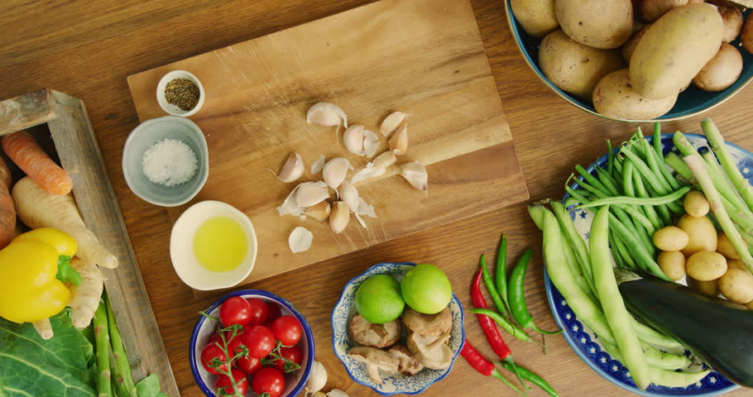
Modify Recipes to Serve Fewer People
Determine how many servings a recipe prepares and how many servings you want to prepare
Plan to reduce the recipe. Reducing recipes to prepare one-half or one-third is common.
Adjust the amount of each ingredient, accordingly
Notes:
Ask: "Has anyone ever thought to themselves, that most recipes you find in cookbooks or online, are written to prepare more food than you need?"
This is a common thought for many people! One option is to modify the recipes you want to use to prepare smaller amounts of food and serve fewer people. To modify a recipe, first determine how many servings a recipe prepares and then decide how many servings YOU want to prepare. Then, plan to reduce the recipe so that you will prepare an amount of food that is more appropriate for you. Common ways to reduce recipes are to prepare half of the recipe or to prepare one-third of the recipe. You will need to adjust the amount of each ingredient you use, based on the amount of the recipe you plan to prepare. For example, if you want to prepare a casserole that serves 8 people, and you need to serve 2 people, you might decide to prepare half the recipe. When you prepare the recipe, you will make prepare 4 servings of the recipe. You will need to reduce the amount of each ingredient you use by half of the original amount listed in the recipe.
Information on the following slides can help you adjust the amount of ingredients you need to use.

Slide 13
To make half of a recipe….
If the recipe calls for…. | Use this amount….
1 cup | 1/2 cup
¾ cup | 6 tablespoons
2/3 cup | 1/3 cup
½ cup | ¼ cup
1/3 cup | 2 tablespoons + 2 teaspoons
¼ cup | 2 tablespoons
1 tablespoon | 1 ½ teaspoons
1 teaspoon | ½ teaspoon
½ teaspoon | ¼ teaspoon
¼ teaspoon | 1/8 teaspoon
1/8 teaspoon | Dash
Notes:
You can use this table to help you easily and quickly adjust your ingredients so that you use the right amount when you want to prepare half of a recipe. Share a few examples from the table.

Slide 14
To make one-third of a recipe….
If the recipe calls for…. | Use this amount….
1 cup | 1/3 cup
¾ cup | ¼ cup
2/3 cup | 3 tablespoons + 1 ½ teaspoons
½ cup | 2 tablespoons + 2 teaspoons
1/3 cup | 2 tablespoons + 2 ¼ teaspoons
¼ cup | 1 tablespoon + 1 teaspoon
1 tablespoon | 1 teaspoons
1 teaspoon | A little bit more than 1/4 teaspoon
½ teaspoon | A little bit less than ¼ teaspoon
¼ teaspoon | A little bit less than 1/8 teaspoon
1/8 teaspoon | Dash
Notes:
You can use this table to help you easily and quickly adjust your ingredients so that you use the right amount when you want to prepare one-third of a recipe. Share a few examples from the table.

Slide 15
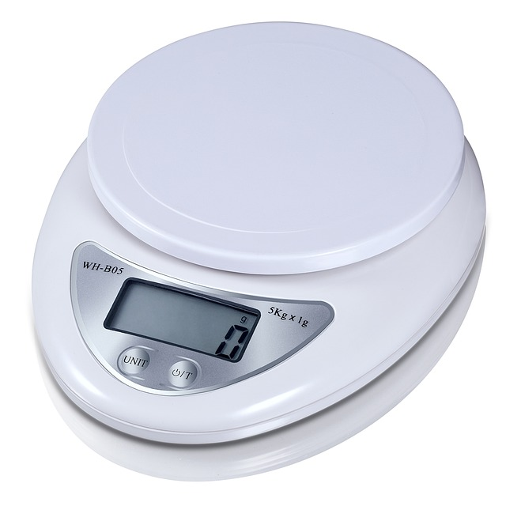
Weigh Ingredients
Use a kitchen scale to measure ingredients
Especially helpful when you are baking
Divide the amount of each ingredient by 2 to prepare half a recipe
Divide the amount of each ingredient by 3 to prepare one-third of a recipe
Notes:
You can also use a kitchen scale to help you measure the correct amount of ingredients for a recipe. Using a kitchen scale can be especially helpful when you are baking and need to measure precisely. You can determine how much of an ingredient you need to use by dividing the original amount by 2 (if you are preparing half of a recipe) or by 3 to prepare one-third of a recipe.
Many recipes will include the weight needed for each ingredient. If your recipe does not, you may be able to search for this information online.

Slide 16
Example
Original recipe:
¾ cup (90 grams) all-purpose flour
To prepare half the recipe:
Use 6 Tablespoons all-purpose flour
Or measure 45 grams all-purpose flour
(90 grams ÷ 2 = 45 grams)
This Photo by Unknown author is licensed under CC BY-SA.
Notes:
For example, if your recipe originally calls for 3/4 cup of all-purpose flour or 90 grams of all purpose flour and you want to prepare half of the recipe, you would need to measure 45 grams of all-purpose flour (90 grams in ¾ cup divided by 2 = 45 grams). You could also refer to the tables on your handout and today's slides to find that you could also measure 6 Tablespoons of flour.

Slide 17
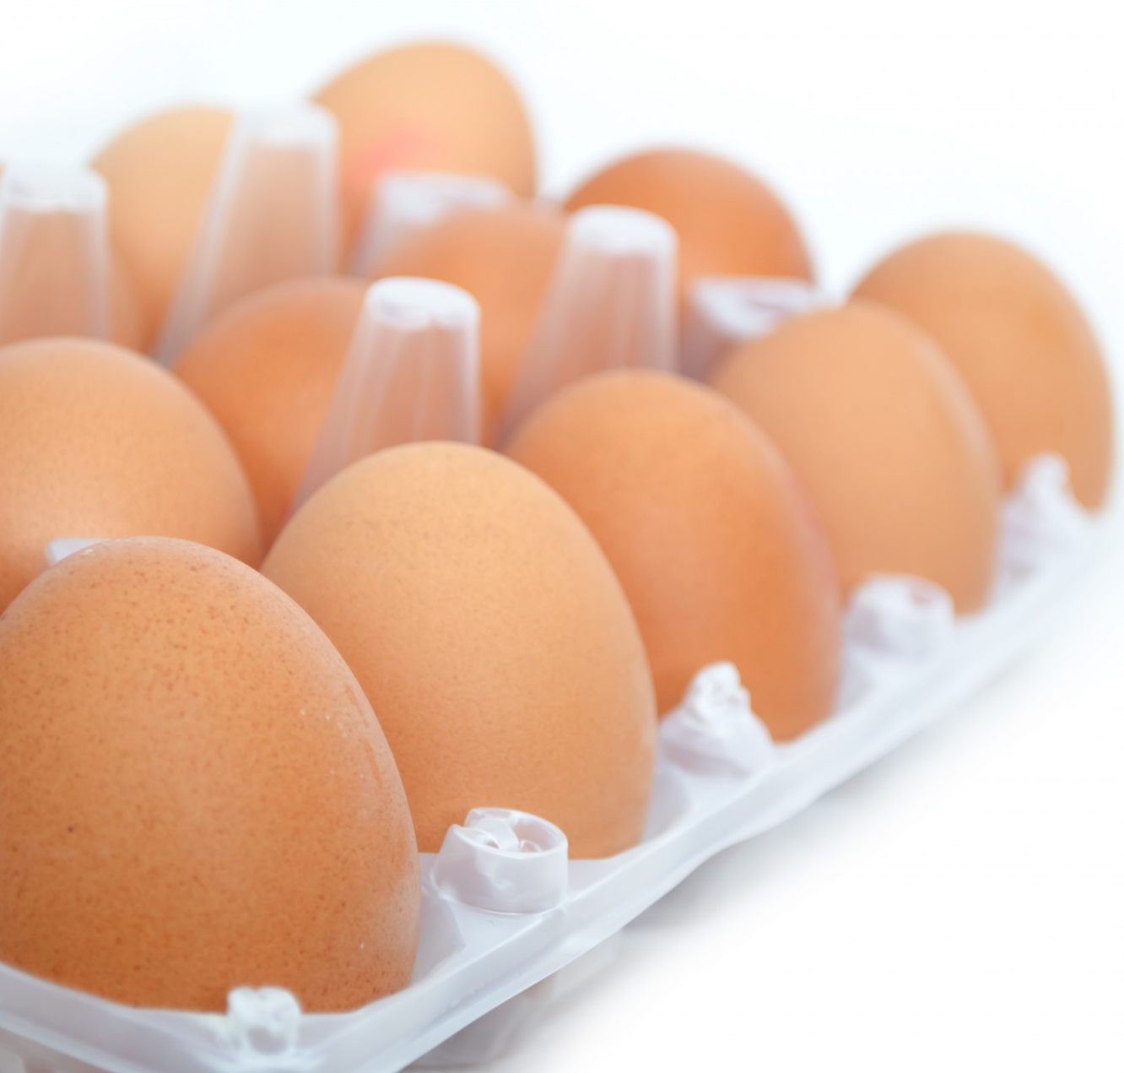
If your recipe calls for an egg...
Crack a large egg and mix in a bowl with a fork and measure the amount of egg you need
For half an egg, use 2 Tablespoons egg
For 1/3 of an egg, use 1 Tablespoon + 1 Teaspoon egg
Refrigerate the egg mixture to use within 2-4 days.
Notes:
If your recipe includes eggs, you may be able to easily modify the recipe by using fewer eggs. For example, if you are preparing half of a recipe that calls for 4 eggs, you can halve the recipe easily by using two eggs. However, if you find yourself in a situation where you’ll need to use less than one egg, the following tips can help out…
First, crack a large egg into a bowl and mix it together with a fork. Then measure the amount of egg you need: Use 2 Tablespoons if you need half of an egg and use 1 Tablespoon + 1 Teaspoon if you need 1/3 of an egg.
Refrigerate the leftover egg mixture to use later. Make sure you use it within 2-4 days.

Slide 18
If your recipe calls for an egg...
If you are using a scale…
A large egg weighs about 50 grams
The yolk of a large egg weighs about 14 g
The white of a large egg weighs about 35 grams
Notes:
Using a scale can also help you easily find the amount of egg you need for a recipe. This technique is especially helpful when you want to modify recipes that call for egg yolks and/or egg whites.
You can use this general guidance to help you estimate. A large egg weighs about 50 grams, out of the shell, The yolk weighs about 14 grams and the whites weigh about 35 grams. You can use these values to help you determine how much egg, egg yolk, or egg white you need to measure for a recipe.

Slide 19
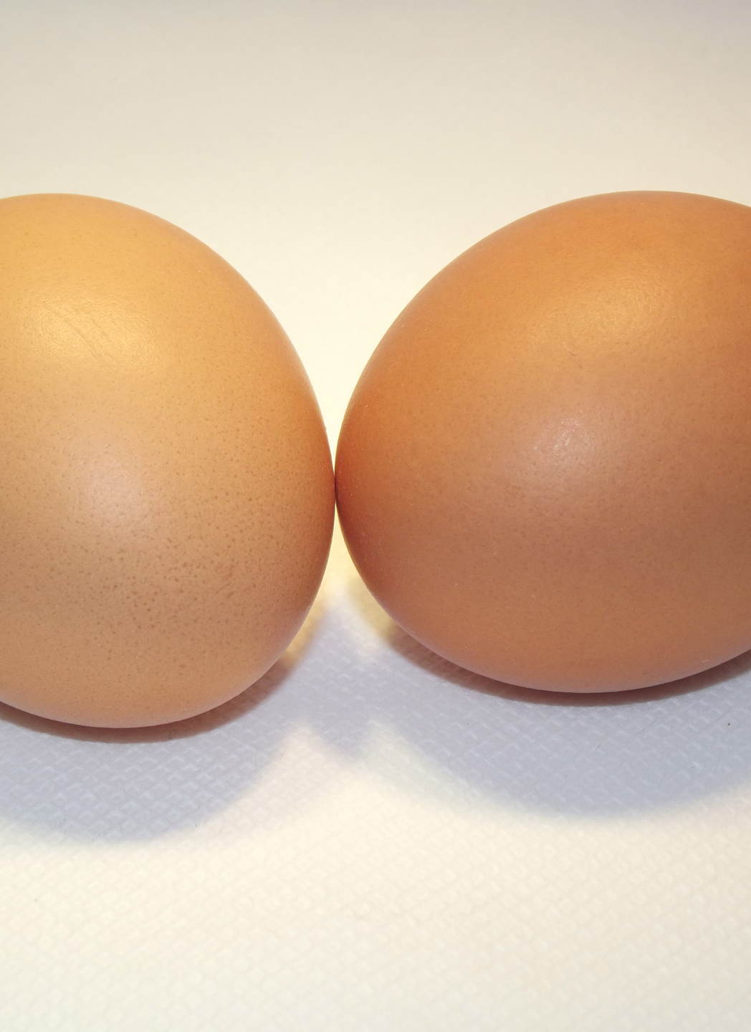
Example
1 large egg and 1 egg white in the original recipe
To prepare half the recipe:
Whisk together the large egg and egg white
(50 grams large egg + 5 grams egg white = 85 grams total)
Weigh 43 grams of the mixture
(85 grams ÷2 = 42.5 or 43 grams rounded)
Notes:
For example, if you want to make half of a recipe that calls for 1 large egg and 1 large egg white, you can mix 1 large egg and 1 large egg white in a bowl. Together, the large egg and large egg white weigh about 85 grams (50 grams for the egg + 35 grams for the egg white). For your recipe, measure about 43 grams (85 divided by 2 = 42.5 grams) of the egg mixture. Refrigerate the leftover egg mixture and use it in another dish within 2-4 days.

Slide 20
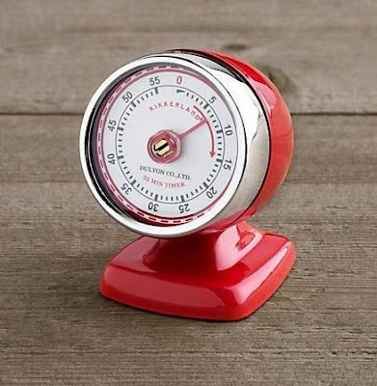
You May Need to Adjust the Cooking Time
Your recipe may require shorter cooking time
Check your dish halfway through the original cooking time
Watch your dishes closely to help you adjust the cooking time
Use a cooking thermometer to ensure you reach a safe internal temperature
This Photo by Unknown author is licensed under CC BY-SA-NC.
Notes:
As you modify recipes, you will likely need to cook the dish for a shorter amount of time than recommended in the original recipe. Consider checking the dish halfway through the original cooking time and then regularly until the dish is done. To make sure the dish is cooked properly, use a cooking thermometer to ensure the dish reaches a safe internal temperature. Throughout the cooking process, watch your dish closely to help you adjust the cooking time of the dish.
**Additional Information for the instructor to share, if desired:
Safe internal temperature for different types of foods are listed below:
Beef, pork, veal and lamb steaks, chops, roasts – 145 F and allow to rest for at least 3 minutes
Ground Meats – 160 F
Ground Poultry – 165 F
Ham, fresh or smoked (uncooked) - 145 F and allow to rest for at least 3 minutes
Ham, fully cooked (to reheat) - 140 F if the ham was not packaged in a USDA-inspected plant. If the ham was not packaged in a USDA-inspected plant, reheat to 165 F.
Poultry – 165 F
Eggs – 160 F
Fish and Shellfish – 145 F
Leftovers – 165 F
Casseroles – 165 F

Slide 21
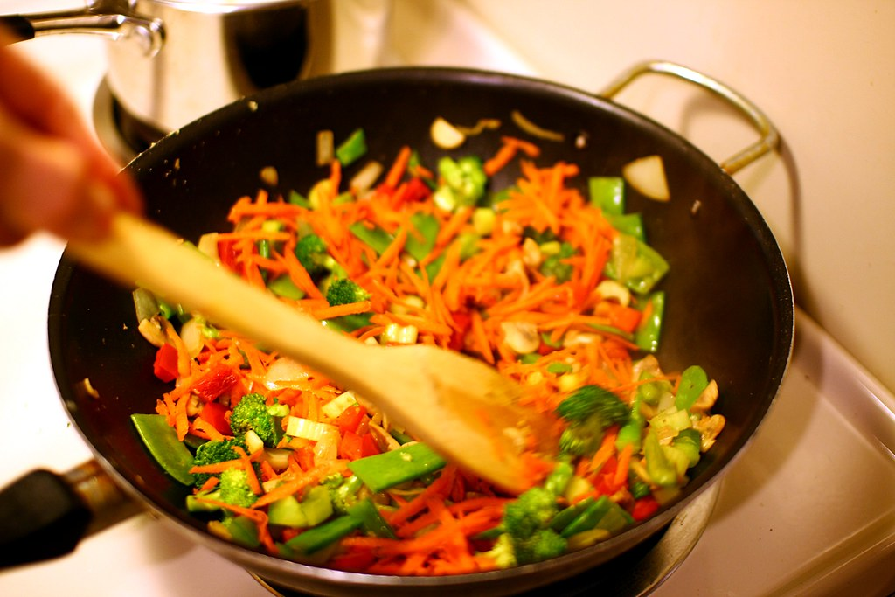
You may need smaller dishes, pots, and pans…
You may need smaller dishes, pots, pans, and other cooking utensils
Find the area of the original pan and adjust to find the area you need
Refer to charts
Calculate the area
This Photo by Unknown author is licensed under CC BY-SA.
Notes:
When you modify recipes to prepare a smaller amount of food, keep in mind that you may need to use smaller dishes, pots, pans, and other cooking utensils than those specified in the recipe. If you are reducing the size of a dish cooked on the stovetop, you may need a smaller skillet or pan.
Choosing the right size pan is especially important if you mare modifying a recipe to prepare baked goods. To find the right size for your modified recipe, first the area of the pan used in the original recipe and then determine the area of the pan you will need to use for your modified recipe, based on how much of the recipe you will prepare. For example, if you are preparing one-half of a recipe, you will need to determine the area of the original pan and then find a pan with about half the area of the original pan.
An easy way to do this is to refer to the charts on the next slide, or you can calculate the area of the pans yourself.
***Additional Information for Instructors to Share, if needed or desired***
To calculate the area of a square pan, multiply the length of the pan by the width of the pan
To calculate the area of a circular pan, multiply 3.14 (or pi) by the radius of the circle squared. The radius of the circle is the distance from the center of the circle to the outer edge (circumference of a circle). The radius of an 8-inch pan is 4 inches, The radius of a 9-inch pan is 4.5 inches.

Slide 22
Area of Baking Pans
Pan Size | Pan Area* | Pan Area to Prepare Half the Recipe*
9-inch x 13-inch pan | 117 inches | 59 inches
9-inch square pan | 81 inches | 41 inches
8-inch square pan | 64 inches | 32 inches
9-inch round pan | 64 inches | 32 inches
8-inch round pan | 50 inches | 25 inches
9-inch x 5-inch loaf pan | 45 inches | 23 inches
8.5-inch x 4.5-inch loaf pan | 38 inches | 19 inches
*Some values are rounded
Notes:
This table lists the area for several popular sizes of baking pans. On the right of the screen you will find the pan area you will need to prepare half of the recipe.
For example,
If you're preparing a recipe for a cake that bakes in a 9 x 13 inch pan, you would need a pan that has an area of about 59 inches. You could consider an 8-inch or 9-inch round pan or an 8x8 inch square pan as the area of these pans is close to the area you need.
If you're preparing a recipe that bakes in a 9-inch square pan, the area of that pan is 81-inches. To. Prepare half the recipe, you will need a pan with an area of about 41-inches. You might consider a 8.5 inch. X 4.5 inch loaf pan.
You can also consider baking some recipes in individual muffin tins, mini loaf pans, or other smaller pans.
You may find that for some recipes, especially recipes for baked goods, it may be easier for you to prepare the original recipe and then freeze some of the foods for later use.

Slide 23
Freezing Prepared Food
Cool food and place in the freezer within two hours.
After cooling, package and freeze the food quickly
Choose packages that are:
Airtight
Moisture-proof
Odor-proof
Vapor-proof
Leave headspace at the top of the container to allow room for the food to expand
Notes:
Freezing food is a useful strategy when you are cooking for yourself or a small group. If you are preparing a recipe and won’t use all of the food before it spoils, consider freezing some of the dish to enjoy later or even to share with a friend or family member. Freezing foods can help you maximize your time, effort, and money by preparing food once and having it on-hand to eat later. This can be especially helpful for days when you are very busy, days that you are tired, and days that aren’t feeling well.
You may also want to freeze food that you purchase but can't use before it spoils. For example, if chicken thighs are on sale at your grocery store, but you won't use the full amount in the package, consider freezing some of the chicken to use later on, if you have space and your food budget allows.
Let's discuss a few things to remember when we are freezing prepared foods at home:
Make sure the food is cooled before freezing. You may need to place the prepared food in a shallow container. Then place the container in a pan or a sink filled with ice water to cool the food. Remember that prepared food should be cooled and in the freezer within two hours.
After the food is cooled, package and freeze the food quickly. When you are choosing packages for your frozen food, make sure the packages are:
Airtight
Moisture-proof
Odor-proof
Vapor-proof
Make sure that rigid containers made of plastic or glass are made for freezing and the cover fits tightly. Many containers have a snowflake symbol on them indicating they are freezer safe.
Freezer bags, freezer wrap, and freezer paper can be used to freeze prepared foods. Freezer bags are useful for foods that have an irregular shape and for liquid packed foods.
When using freezer bags, make sure you press and remove as much air as possible before sealing.
Foods expand when they freeze, so make sure you leave some headspace at the top of the container to allow for expansion.
You can refer to the handout about freezing foods to learn more about guidelines for leaving enough headspace and to learn more about freezing different types of foods.

Slide 24
Thaw Frozen Food Safely
In a refrigerator with a container to avoid drips and spills
In cold water in water poof wrapping. Change the water every 30 minutes
In the microwave using the defrost setting
Do not thaw food at room temperature
Notes:
When you are ready to use foods that you thawed, remember to thaw foods safely. You can safely thaw foods by placing the package in a refrigerator with a container to avoid drips and spills; in cold water with the foods packaged in waterproof wrapping, changing the water every 30 minutes so the water remains cold, or in the microwave using the defrost setting. Foods should not be thawed at room temperature.

Slide 25
Roast Chicken with Oranges
Serves: 4
Ingredients
4 chicken thighs, trimmed of excess fat
1 red onion, peeled and sliced
2 small oranges, peeled, seeded, and sectioned
½ teaspoon salt
½ teaspoon black pepper
1 lemon, peeled, seeded, and cut into quarters
Directions
1. Preheat the oven to 450 F.
2. Place the chicken, onions, and oranges on a baking sheet and spread items evenly to avoid overlap.
3. Sprinkle the chicken with salt and pepper.
4. Place the baking sheet in the oven and bake, about 45 minutes, or until the internal temperature of the chicken reaches 450 F.
5. Remove the baking sheet from the oven and place the chicken on a serving platter.
6. Squeeze the juice from the lemon quarters over the chicken.
7. Top the chicken with the oranges and onions. Enjoy!
Recipe adapted from SNAP-ED NY
Notes:
Ask: "Let's imagine you want to prepare this recipe for roast chicken and oranges. The recipe serves 4 but you only want to serve 1-2 people. What are some things you might do?"
Possible answers include:
Prepare half the recipe
Prepare the full recipe and enjoy the roast chicken at a later meal
Prepare the full recipe and repurpose the roast chicken into another dish later. You might use the chicken to prepare chicken salad, or serve the roast chicken on top of a bed of greens and other fruits and vegetables, you could add the roast chicken to a pasta dish or a grain bowl, or incorporate the roast chicken in a wrap, casserole, or soup.
Advise participants that this recipe is included on the handout for the lesson if they would like to prepare the dish at home.

Slide 26
Wrap-Up
Find ways to make your mealtimes enjoyable to you
Remember to include foods that nourish your body
Balance convenience with cost and nutrition
Make the most of your time and money with leftovers and planned over
Explore customizable dishes
Modify recipes
Freeze and thaw food safely
Notes:
Today, we talked about a few different strategies we might use when we are cooking for ourselves, for two people, or even for a smaller group of people. Sometimes cooking for one or two people can be challenging, so remember to look for the ways that make mealtimes pleasant and enjoyable for you. Remember to choose meals and snacks that give our bodies all the nutrients we need to be our best, and balance convenience options with their cost and their nutritional value. Make the most of your valuable time and money by using leftovers and planned overs and explore your creativity with customizable dishes. Modifying recipes and freezing food can also be useful tools, especially if you find that many recipes prepare more food than you'll need!
Ask if participants have any questions or comments.
Ask: "Did anyone think of a strategy that would like to try, or will continue doing, when you are cooking for 1 or 2 people?" Ask for a few volunteers to share.
Encourage participants to try different strategies for cooking for one to two people. It may take time to find the techniques that work best for you!

